Slide 1


CAPSTONE PROJECT: CAR INSURANCE LOAN DATA
By Ross Newton & Abey Antony
Using Data Analytics and Machine Learning to understand the attributes of a customer who would claim for a loan to pay their car insurance claim.
Explore the fascinating world of car insurance data analysis and uncover valuable insights into loan applications after accidents.

Slide 2
INTRODUCTION
Why we selected this dataset?
We chose this dataset because we have a keen interest in understanding customer behaviour and the factors that contribute to car insurance loan claims.
By analysing this data, we aim to demonstrate our ability to add value in this domain.
What does it mean when someone claims a loan on their car insurance?
Notes:
Introduction & Motivations
You should introduce yourselves, and the project. You should introduce your project from a business perspective: what questions were you trying to answer with your data?
Introduction gives an excellent overview of the presentation and introduction to speakers. Introduction provides an outstanding explanation of the goals of the project and the motivations underlying the choice of dataset.
When someone claims a loan on their car insurance, it means that they are taking out a loan using their car insurance as collateral. This means that the person's car insurance policy will be used as a guarantee that the loan will be repaid. The loan can be used for a variety of purposes, such as fixing a car that is damaged in an accident, replacing a car that is stolen, or paying for medical bills that are related to a car accident.

Slide 3

QUESTIONS AND HYPOTHESES
What attributes of the customer most impact whether they are going to claim for a loan?
Is gender of a driver correlated with whether the driver submits a claim for a loan or not? (Are male drivers more likely to submit a loan claim than females or vice versa?)
Are drivers in a lower income class and lower education are more likely to use a loan to pay for car insurance ?
Are younger drivers are more likely to use a loan to pay for car insurance claims than older drivers ?
Are people with past accidents, DUIs and speeding violations are more likely to claim for a loan on their car insurance?

Slide 4
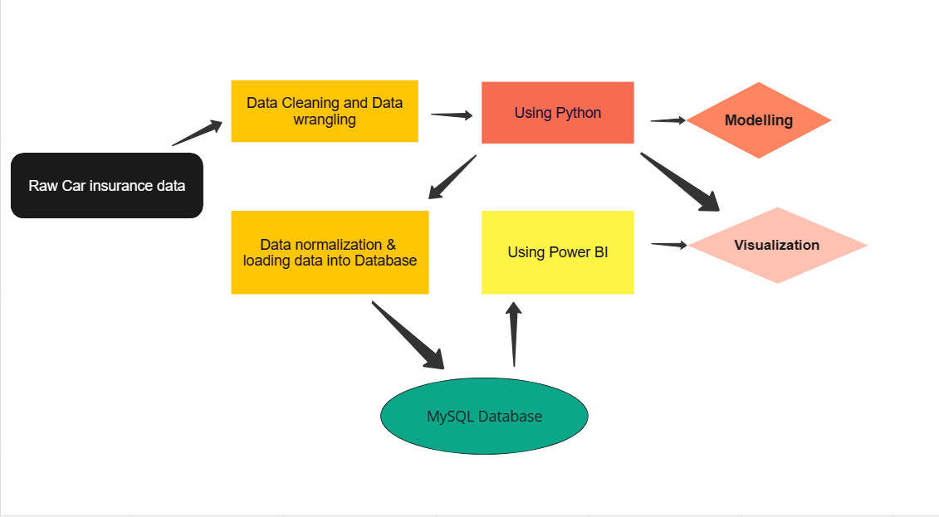
DATA ANALYSIS & PREDICTIVE MODELLING PROCESS

Slide 5

PROCESSING THE DATA
Python/Pandas
Notes:
Outstanding practical data skills are demonstrated. Examples include strong skills in any of Python/Pandas, MongoDB, SQL, Power BI, AI/ML. Demonstration of skills in any technology relevant to data engineering will be considered.

Slide 6
DATASET OVERVIEW
Quality
Distribution
Anomalies
Completeness
Consistency
Accuracy
Relevance
Notes:
Outline the chosen dataset in terms of its size, nature, and limitations. You may wish to discuss any points that arose during data cleaning. If you combined data from multiple sources, you should discuss how the data was combined.

Slide 7
DATABASE STORAGE
Why put the data into a database?
Why are the tables normalised/split up?
Database Relationship Types
Notes:
Storing and managing data
Analyzing data - easy to maintain data

Slide 8
PROCESSING THE DATA FOR STORAGE
SQL
Notes:
Outstanding practical data skills are demonstrated. Examples include strong skills in any of Python/Pandas, MongoDB, SQL, Power BI, AI/ML. Demonstration of skills in any technology relevant to data engineering will be considered.

Slide 9
ENTITY RELATIONSHIP DIAGRAM (ERD)

Slide 10
INSIGHTS & VISUALIZATION
Power BI
Python
Notes:
Outstanding practical data skills are demonstrated. Examples include strong skills in any of Python/Pandas, MongoDB, SQL, Power BI, AI/ML. Demonstration of skills in any technology relevant to data engineering will be considered.

Slide 11
MACHINE LEARNING
Logistic Regression
Decision Tree.
K-Nearest Neighbors (KNN)
Random Forest.
XGBoost (Extreme Gradient Boosting)

Slide 12
DISCUSSION OF TECHNOLOGIES IN DATA ENGINEERING
How could our pipeline be adapted using any data engineering technologies which we did not use?
Advantages and limitations, and any practical or business concerns that must be considered when using these technologies.
Notes:
You should discuss how your pipeline could be adapted using any data engineering technologies which you did not use. For example, you could focus on one or two of the following: cloud technology, Spark, data warehousing, data lakes or AI/ML. Discuss the advantages and limitations, and any practical or business concerns that must be considered when using these technologies.

Slide 13
CONCLUSION
Summary:
The analysis of car insurance data provides valuable insights into customer behaviors.
Predictive modeling can effectively identify factors influencing customer insurance claims.
Future Directions:
Continuously refine the predictive model with updated data and improved algorithms.
Explore deeper into customer behaviour patterns using advanced data analysis techniques.
Investigate the impact of external factors, such as driving habits and environmental conditions, on insurance claims.
Notes:
This is your opportunity to show your data analytics skills. You should present analyses and visualisations created that explore your group’s business questions
---
Outlines outstanding and insightful conclusions about the chosen dataset.
Key Findings:
Uncover the most influential factors driving customer insurance claims.
Identify patterns and trends related to customer behavior and risk assessment.
Practical Applications:
Inform personalized insurance offerings based on customer profiles and risk factors.
Develop targeted marketing campaigns to improve customer retention and loyalty.
Enhance risk assessment and pricing strategies for car insurance & loan products.

Slide 14




THANK YOU
Ross Newton & Abey Antony

